Slide 1
Best Practice:
Campaign Management for Marketing Professionals
Salesforce.com Customer Success
January 2009
Notes:
Contributors to this best practice presentation consist of the following individuals from Salesforce.com
Pat Cameron, Sr. Customer Success Manager (primary author)
Lisa Taylor, Sr. Customer Success Manager
Anne Moore, Customer Success Manager

Slide 2

Campaigns Best Practices
Business Driver
Best Practice Overview
Best Practices: Campaign Management
  Campaign Preparation
  Campaign Execution
  Campaign Tracking
Tools & Resources
NOTE: Campaigns are included with Enterprise Edition, and available for an additional cost with Professional Edition. In the Professional Edition, one campaign license is consumed for each user that has the "Marketing User" box checked.

Slide 3


Campaign Management

Slide 4
Campaign Preparation
How to target campaigns: Define who you want to target
Existing Customers
  Your Marketing and Sales organizations should collaborate to capture essential customer information in the application to assist with defining your targets
    Define and configure the necessary custom fields to help with segmentation definitions; consider using picklists, dependent picklists etc. to make your targeting, customer segmentation and reporting more effective
Existing Leads
  Consider lead scoring and lead status with customer segmentation in mind
    For example, a series of archived status definitions (e.g. No Interest, Future Interest, Nurture)
New Leads - Adding 3rd Party Lists in Salesforce
  Some companies incorporate 3rd party prospect/lead lists inside of Salesforce with a specific 3rd party designation (e.g. by record type, or assign to queue, or specific pre-qualification process before passed to Sales)
    De-dupe against existing records in your Salesforce database to determine which are existing Customers, existing Prospects or Net New names
  Some companies purchase 3rd party lists containing “suspect” names which are not added to your Salesforce application until a response has been received or the name has been qualified
    Consider de-duping this list outside of Salesforce with partner tools (e.g. PeopleImport by CRM Fusion) then importing into Salesforce
Notes:
There are basically 3 types of targets: existing customers, existing leads and new leads.
Existing Customers:
Your target audience very much depends on what your objective is for your campaign. If you need to enhance your brand and provide education for continued customer loyalty, targeting existing customers is the obvious choice. So, think about how you segment/tag your customers today and what fields you need to help you in your efforts. Collaborate with Sales to determine various way to capture the details you need.
Existing Leads:
I know Lead scoring is not new and you might already be using the Lead Status field but these are important fields to help target campaigns. You might want to re-evaluate your current settings for Lead Status. For inbound inquiries for example, consider all the choices for your company for Lead Status field like: New, Working, Archived – Bad Data, Contact – Recent Activity, Partner Interest (if using PRM), Contact – No Oppty (converted to contact but no net new business), Contact – Current Oppty (converted to Contact, current Opportunity exists for same Product on Account), etc.
New Leads:
We list out a couple of options for managing new leads. As you can imagine, there are a number of ways to manage new leads but the objective is to make sure you are de-duping them against your existing customers, whether you do that inside Salesforce or outside of Salesforce is up to you. They are both feasible. The best practice really depends on quantity but be sure to track your lead source, especially for your net new leads. (Note: For Option 1, during this process, Campaign information is moved to the existing record. Net New Leads are Suspect records which are worked to qualify to convert to an Account/Contact/Opportunity).

Slide 5


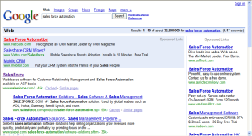
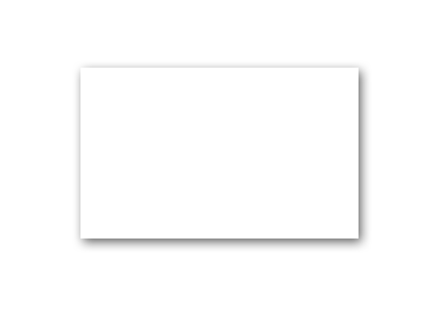
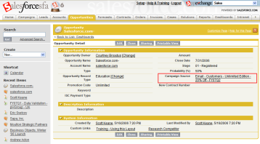
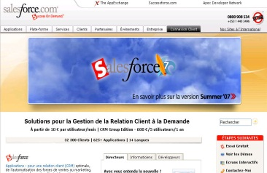
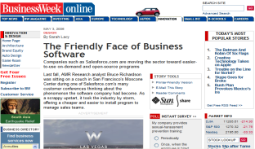
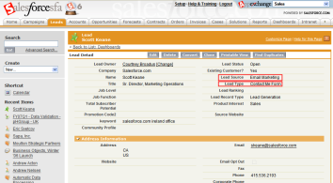
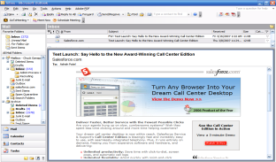


Campaign Preparation
Determine campaign programs: Decide your channels and process
Phone/Telemarketing
Search Engine/ Google Ad Words
Inside Opportunities
Website
Lead Capture/
Lead Qualify
PR/Events
Field Opportunities
Email
Events
Tips & Tricks
Be sure to have a process defined for your programs and Campaigns
Notes:
Some common campaign programs and channels include (some listed above) Web form, phone, personal e-mail, registration/attendance for a conference, tradeshow or web seminar (events).
If your Marketing Campaign has a web component, i.e. a landing page or registration page, your responses can flow through your website and be captured as new “Leads” in Salesforce with the use of Web-2-Lead which we discuss later. The main point is to have a process defined for your campaign. For example, if you have an inside sales team or some form of internal telemarketing organization which receives and qualifies all inbound responses will combined with their attention to your Campaign, and diligence in follow-up, will positively impact your Pipeline generated.
Example: Our example above illustrates a process representing an inside sales rep who will first review the inbound response and determine if it is from an existing Customer, existing Prospect or is a net new Suspect. From there, the inside sales rep will route the response to the correct owner for follow-up and create the field opportunity, or make an outbound phone call to qualify the response and create an inside opportunity to work. This process may vary depending on your organization but it is very important to outline your process.

Slide 6
Campaign Preparation
Define campaign access: Who should have access to campaigns?
Determine who should have access to Campaigns
  Be default, all users have view access to campaigns, advanced setup and run campaign reports
The Marketing User check box on the user profile page indicates whether or not a user has the right to create and manage campaigns including:
  Create a new campaign
  Edit or delete an existing campaign
  Update campaign statistics
  Import leads into a campaign**
  Mass update the status for members of a campaign**
  Configure advanced campaign setup to define member status values
  Run campaign reports across multiple campaigns
** In order to use the campaign import wizards, Marketing Users must also have the Marketing User profile (or the "Import Leads" permission in Enterprise Edition organizations).
Notes:
If you are just getting started with Campaigns, you will want to limit creation/management of Campaigns to just Marketing. In order to “turn on” the capabilities needed, you need to check the “Marketing User” checkbox in the user profiles of your marketing team. But other users (aka Sales) will have visibility to your campaigns which is important as you will involve them in certain campaigns especially the ones that help him/her sell more. This slide is more housekeeping for you so you have an idea of campaign access. For larger marketing organizations or companies with multiple business units and separate marketing teams, you can set up Campaign Sharing but only if you selected Private for your organization wide default for Campaigns. Then you can “open up” access per public groups, roles, and roles & subordinates (and these rules can be recalculated just like all other sharing rules).

Slide 7
Agenda
Campaign Preparation
  Goal of the Campaigns
  How to Target Campaigns
  Determine Campaign Programs
  Define Campaign Responses
  Define Campaign Access
Campaign Execution
  Build Campaign
  Campaign Tools
  Campaign Members
  Mass E-mail
Campaign Tracking
  Campaign Responses
  Campaign Measurement

Slide 8
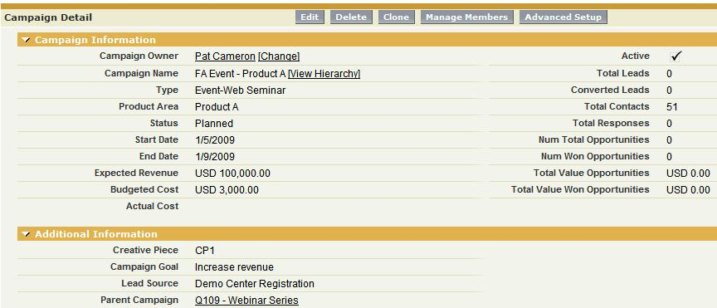

Campaign Execution
Build campaign: Include key fields for tracking
Tips & Tricks
Have a naming convention: e.g. EMEA – FY08Q3 – Success Tour - Brussels
Tips & Tricks
Update the Type picklist field and keep the total number of values to no more than 10 and include general types
Tips & Tricks
Define your lead source
values so they tie back to budget dollars
Tips & Tricks
Tie campaigns together with the “Parent Campaign” field
Notes:
We discussed key category fields earlier but here is an example. We have a parent campaign for an overall Webinar series but this particular campaign represents the Webinar event for driving sales/interest for a particular product (notice the Product Area field).
Although this screen shot does not follow the recommended naming convention in the tips & tricks box, you get the idea! You can also “sub-type” in your naming convention. For example, you can do that in your “Type” picklist or use dependent picklists to accomplish this. You could have “Type” defined as “Event” and have a dependent picklist called “sub-type” and have values such as web seminar, tradeshow, conference, seminar, etc. It’s important to track your success rate and capture which campaigns are effective while you track your costs, etc.
Notice the “Lead Source” field, it’s important to understand where your traffic is coming from for this campaign, again for tying back your budget dollars. We are all trying to do more with less!

Slide 9
Campaign Execution
Build campaign: Categorizing for campaign measurement
Products and services
  Create a campaign picklist field for Product or Focus Area
Advertisements and publications/media
  Create a picklist field for Ad Type with values such as Magazine, Newspaper, Online, etc.
  Create another picklist for specific publication so you can report on both levels
Agencies creating materials
  Track which agencies are tied to your successful campaigns by creating a Creative Source or Creative Piece picklist field
Offers made in campaigns
  Track the different types of high-level offers (e.g. whitepapers, demos, web seminars) to track overall effectiveness
Notes:
Here are some ideas for further classifying and categorizing your campaigns to help you track product interest (which products are more popular, where should you spend your time), advertisements (which publications are better than others, which one should you drop), agencies (is there a correlation to poor performing campaigns and creative work), and offers (are demos the key to success, what offers seem to do the trick). These are just some initial ideas but you might have many more!

Slide 10
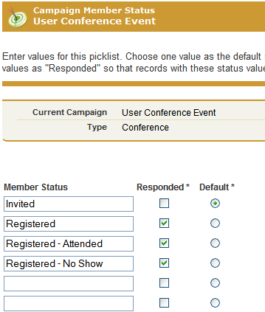
Campaign Execution
Build campaign: Set up member response status values
Tips & Tricks
Member Status tells Sales exactly what their prospect or customer did
Tips & Tricks
You can have more than one “Responded” value!
Tips & Tricks
# Responses metric is the sum of all members with a status checked as “responded”
Notes:
In a nutshell, you can set up different member status’ which tell you and Sales exactly what your customer or prospect did. Not only that, it can also tell you what the follow-up steps should be. Upon setting these up, you select which action counts toward a response to you. For this user conference event example, we are considering whether they registered, registered w/ attendance and registered w/ not showing up as a response. You can always report on conferences with no shows to help in future planning. The “Total Responses” field/metric on the campaign page in the previous slide counts the number of members who have a responded status. Each member can only have one associated status which avoids double counting.

Slide 11
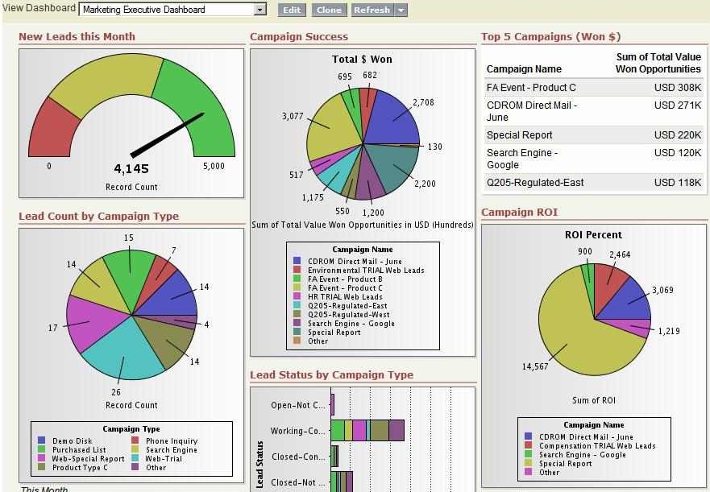

Campaign Tracking
Campaign measurement: Measure overall campaign effectiveness
Build your own
Leverage
for Pre-built Dashboards
Marketing Metrics Dashboard 1.0
Marketing Targets Dashboard 1.1
Notes:
Set up the dashboard that is right for you and measure the success of your campaigns. Our AppExchange does provide you with a couple which will save you a lot of time (see links above). Remember you can always customize whatever you download.

Slide 12
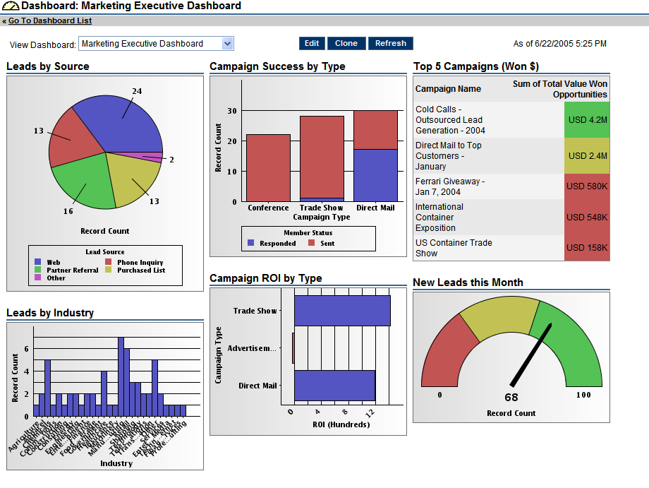





Campaign Tracking
Campaign measurement: Proven customer success
Measuring and Improving Business
100% increase in lead conversion rate.
Reduced time for preparing email campaigns by 95%.
Campaign Analysis
Campaign Revenue
Lead Management
Went from managing 1 to 16 simultaneous campaigns.
Increased lead conversion by 400%.
Campaign ROI
Lead Tracking
Leads Analysis
“40 percent reduction in time to build email marketing sends”
“Increased lead generation by 20 percent and reduced follow-up time by 50 percent”
“40 percent reduction in time to build email marketing sends”
Notes:
To measure the success of marketing programs in real-time, our customers use dashboards that can be used to measure any marketing metric that is critical to your organization. For First American, they measure lead conversion rates. First American increased lead conversion rates by 100% by closing the loop in marketing with Salesforce. First American’s primary problem was neglected leads. Sales wasn’t following up on every lead and no one was holding them accountable. With Salesforce Marketing, First American solved the problem not only by tracking every lead, but by customizing lead information to attach the right information to every lead every lead was better qualified.
Salesforce.com conducts a quarterly on line Relationship Survey, hosted by CustomerSat (www.CustomerSat.com). Respondents mentioned some of the above CRM success metrics they have achieved with Marketing from their use of Salesforce.

Slide 13


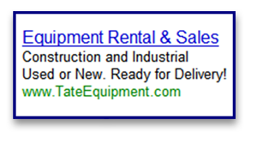





Sales and Marketing: Tools and Terminology
Below you’ll find the tools and terminology used in the application and online training. For more information visit Salesforce Community, the Salesforce.com Online User Community. You can search the site, browse around, and see what the community is interested in.
A campaign is an outbound marketing project that you want to plan, manage, and track within Salesforce. It can be a direct mail program, seminar, print advertisement, email, or other type of marketing initiative.
Accounts are your organization's customers, competitors, and partners. Each account stores information such as name, address, and phone numbers. For each account, you can store related information such as opportunities, activities, cases, partners, contracts, and notes.
Campaigns
Accounts
Google AdWords™ is an online advertising service used to create advertisements that display on major search engines, including Google. Many Salesforce customers advertise online with Google AdWords as a mechanism to generate leads.
Contacts are all of the individuals associated with your business accounts that you need to track in Salesforce. You can store various information for a contact, such as phone numbers, addresses, titles, and roles in a deal.
Google AdWords
Contacts
Opportunities are the sales and pending deals that you want to track. By adding opportunities, you are also building your “pipeline,” which will contribute to your forecast. You can also link opportunities to campaigns to help measure the ROI of your marketing programs.
With Web-to-Lead, you can gather information from your company’s website and automatically generate leads. Web-to-Lead form can be used for contact me requests, registration pages, or campaign landing pages.
Web-to-Lead Form
Opportunities
A lead is a prospect or potential opportunity - a person you met at a conference who expressed interest, or someone who filled out a form on your company’s website.
Products are the individual items that you sell on your opportunities. You can create a product and associate it with a price in a price book. Each product can exist in many different price books with many different prices. A product that is listed in a price book with an associated price is called a price book entry.
Leads
Products
Notes:
If you are interested in renaming salesforce.com’s standard application terminology for your own company deployment, read the help documentation then log a case to have it enabled in your account.

Slide 14








Sales and Marketing: Tools and Terminology
Below you’ll find the tools and terminology used in the application and online training. For more information visit Salesforce Community, the Salesforce.com Online User Community. You can search the site, browse around, and see what the community is interested in.
A forecast is your best estimate of how much revenue you can generate in a quarter. This amount is divided between Commit Amount - the amount you can confidently close - and Best Case Amount - the total amount of revenue you might possibly generate. A manager’s forecast should include the amount of revenue the entire team can generate together.
Tasks are to-do items that need to be followed up on. They can be associated with accounts, contacts, leads, or other custom objects. You can follow up on the task yourself, or assign it to another user.
Forecasts
Task
Maintain a historical record of all activities related to an account, contact, or opportunity. Your activity history includes emails, call notes, and calendar events, so everyone is on the same page.
A contract is a written agreement between two or more parties. Many companies use contracts to define the terms for doing business with other companies. Track the contract through your organization’s approval process and use workflow alerts to notify yourself when to initiate contract renewals.
Activities
Contracts
Reports are lists, summaries, and analyses of your data, which you can display or print. To help you monitor your organization, Salesforce offers a wide range of standard reports, accessible in the Reports tab. You can also create new custom reports to access exactly the information you need. You can subtotal and limit your data to help you analyze trends and get a concise picture of what is happening in your organization.
A document library is a place to store files without attaching them to accounts, contacts, opportunities, or other records. Each document in the document library resides in a folder. The folder’s attributes determine the accessibility of the folder and the documents within it.
Reports
Documents
Dashboards give you a real-time snapshot of corporate metrics and key performance indicators. A dashboard is a group of different charts (or components) that graphically display your custom report data. You can select up to 20 different custom reports to display data graphically as charts in each dashboard.
Group calendaring will helps you better collaborate as a team, and arrange meetings with prospects and customers.
Calendar Events
Dashboards
Notes:
If you are interested in renaming salesforce.com’s standard application terminology for your own company deployment, read the help documentation then log a case to have it enabled in your account.

Slide 15


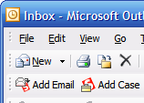
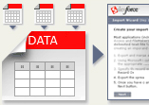

Sales and Marketing: Tools and Terminology
Below you’ll find the tools and terminology used in the application and online training. For more information visit Salesforce Community, the Salesforce.com Online User Community. You can search the site, browse around, and see what the community is interested in.
Make searching data and interacting with the results of your searches simple, smooth, and highly effective. Inline paging and sorting features simplify the task of working with large sets of search results. Powerful filtering and scoping functions narrow searches and results. Customization options enable users to design search results layouts that are tailored for the way they work.
With Salesforce you can create email templates for common emails such as web-to-lead responses, sales prospecting, announcements, and internal workflow. You can even personalize parts of the email with information from the contact or account record.
Email Templates
Search
Plan and execute email campaigns targeted at prospects and customers. Enterprise Edition customers can send 500 emails per mass mailing, while Unlimited Edition customers can send 1,000 emails per mass mailing. Salesforce can also integrate with third-party marketing solutions and offers out-of-the-box integration with several top email marketing vendors.
Outlook users enjoy high levels of productivity with Apex Connect Outlook—formerly called Outlook Edition—which makes it easy to synchronize important customer data between two commonly used applications. With Connect Outlook 3.0 in Spring ’07, productivity for Outlook users gets another boost with several enhancements. Users can add emails with attachments, create contacts and leads directly in Outlook, and create relationships between calendar events and associated objects such as accounts and opportunities.
Mass Email
Connect Outlook
✓
Evaluate the success of email campaigns with integrated response tracking and easy monitoring of key campaign metrics, such as whether recipients open the messages, when they open them, and more.
Email Tracking
You can set up a Web-to-Lead form to capture contact me requests from your company’s website. With a lead de-dupe solution you can automatically route those requests to the person who owns the account.
The ability to easily import data into Salesforce is one of the application's key benefits. Import excel worksheets or CSV (comma separated value) files. Map the information to leads, contacts, accounts, solutions, and custom objects. Search Import Tools on Salesforce Community for more information.
Web-to-Lead Form
With computer-telephony integration (CTI) capabilities, you can directly integrate your telephone network into Salesforce and access it entirely through the familiar, browser-based Salesforce interface. With the combined power of CTI and the new Salesforce Console, salesforce.com delivers unlimited productivity to your call centers.
Import Wizard
CTI Integration
Notes:
If you are interested in renaming salesforce.com’s standard application terminology for your own company deployment, read the help documentation then log a case to have it enabled in your account.

